Slide 1


By CTRL+ALT+ELITE Vistula

Slide 2
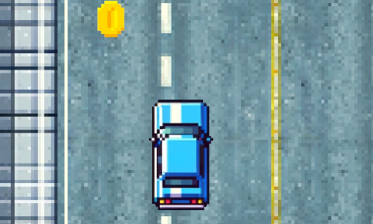
Game Identity
Our game is a mobile endless-runner about taxi driver who is desperately trying to get to his client by going through many dangerous obstacles.
We have taken inspiration from first GTA games and desire to recreate experience that this game gave players almost 30 years ago.

Slide 3

Design Patterns
Accomplishment
Challenge
Excitement

Slide 4
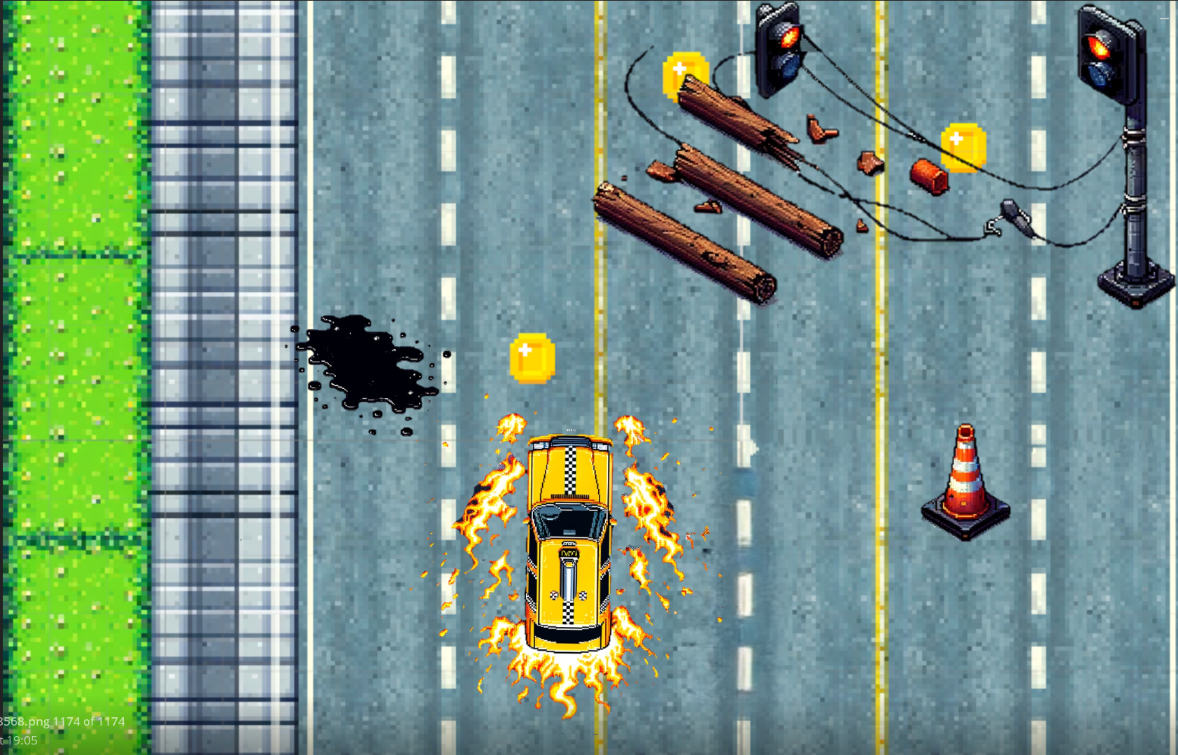
Mechanics Summary
As was mentioned Taxifire is an endless-runner 2D mobile game. Our taxi driver will be rushing through the streets of New-York to get to his client.
Player is chased by a big traffic jam tsunami, so he cannot stay at the same place for to long, otherwise he will get flattened by traffic.
On his way, player will encounter many obstacles, like: fallen trees, other cars, cones, broken traffic light, etc. Some of them may just slower the car, others will cause game over.
Main task will be to achieve as much as possible points. To gain them player must collect coins or pick up other passengers and drop them on when they will ask.

Slide 5

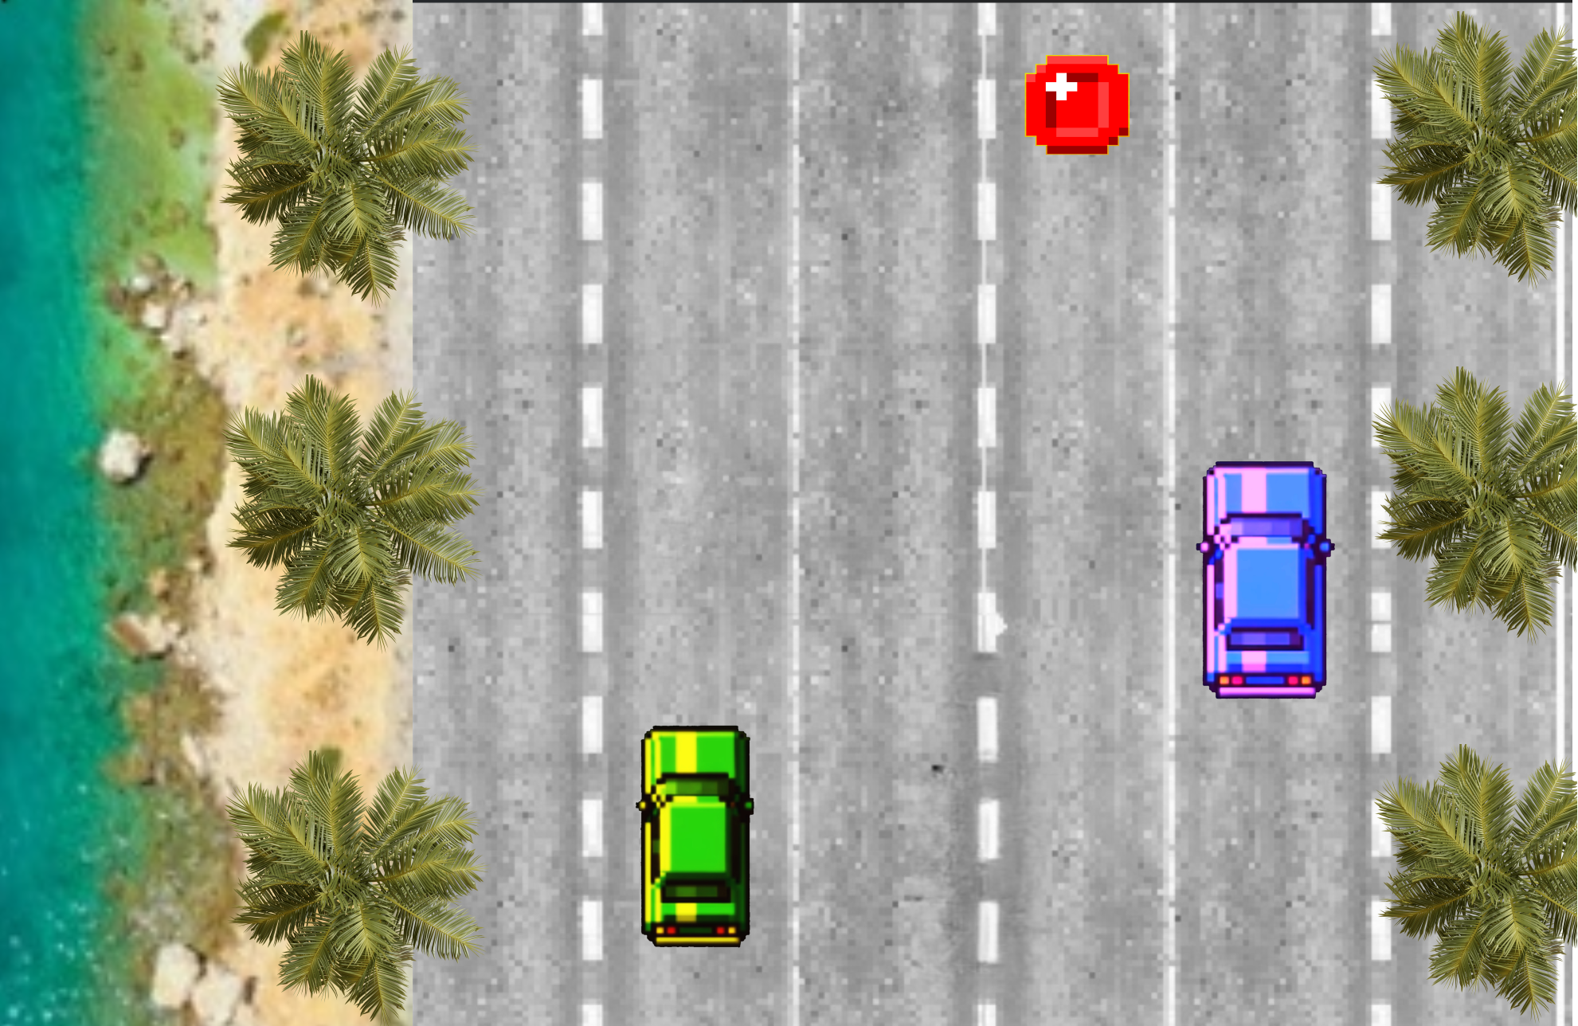

Features
Some coins may give you special powers or extra points.
Player will be able to visit different locations, by traveling via portals/passages. For example: Street, Zoo, Forest, Shore.
You can change your car and upgrade it during the ride (or from the menu. They may have special powers.

Slide 6
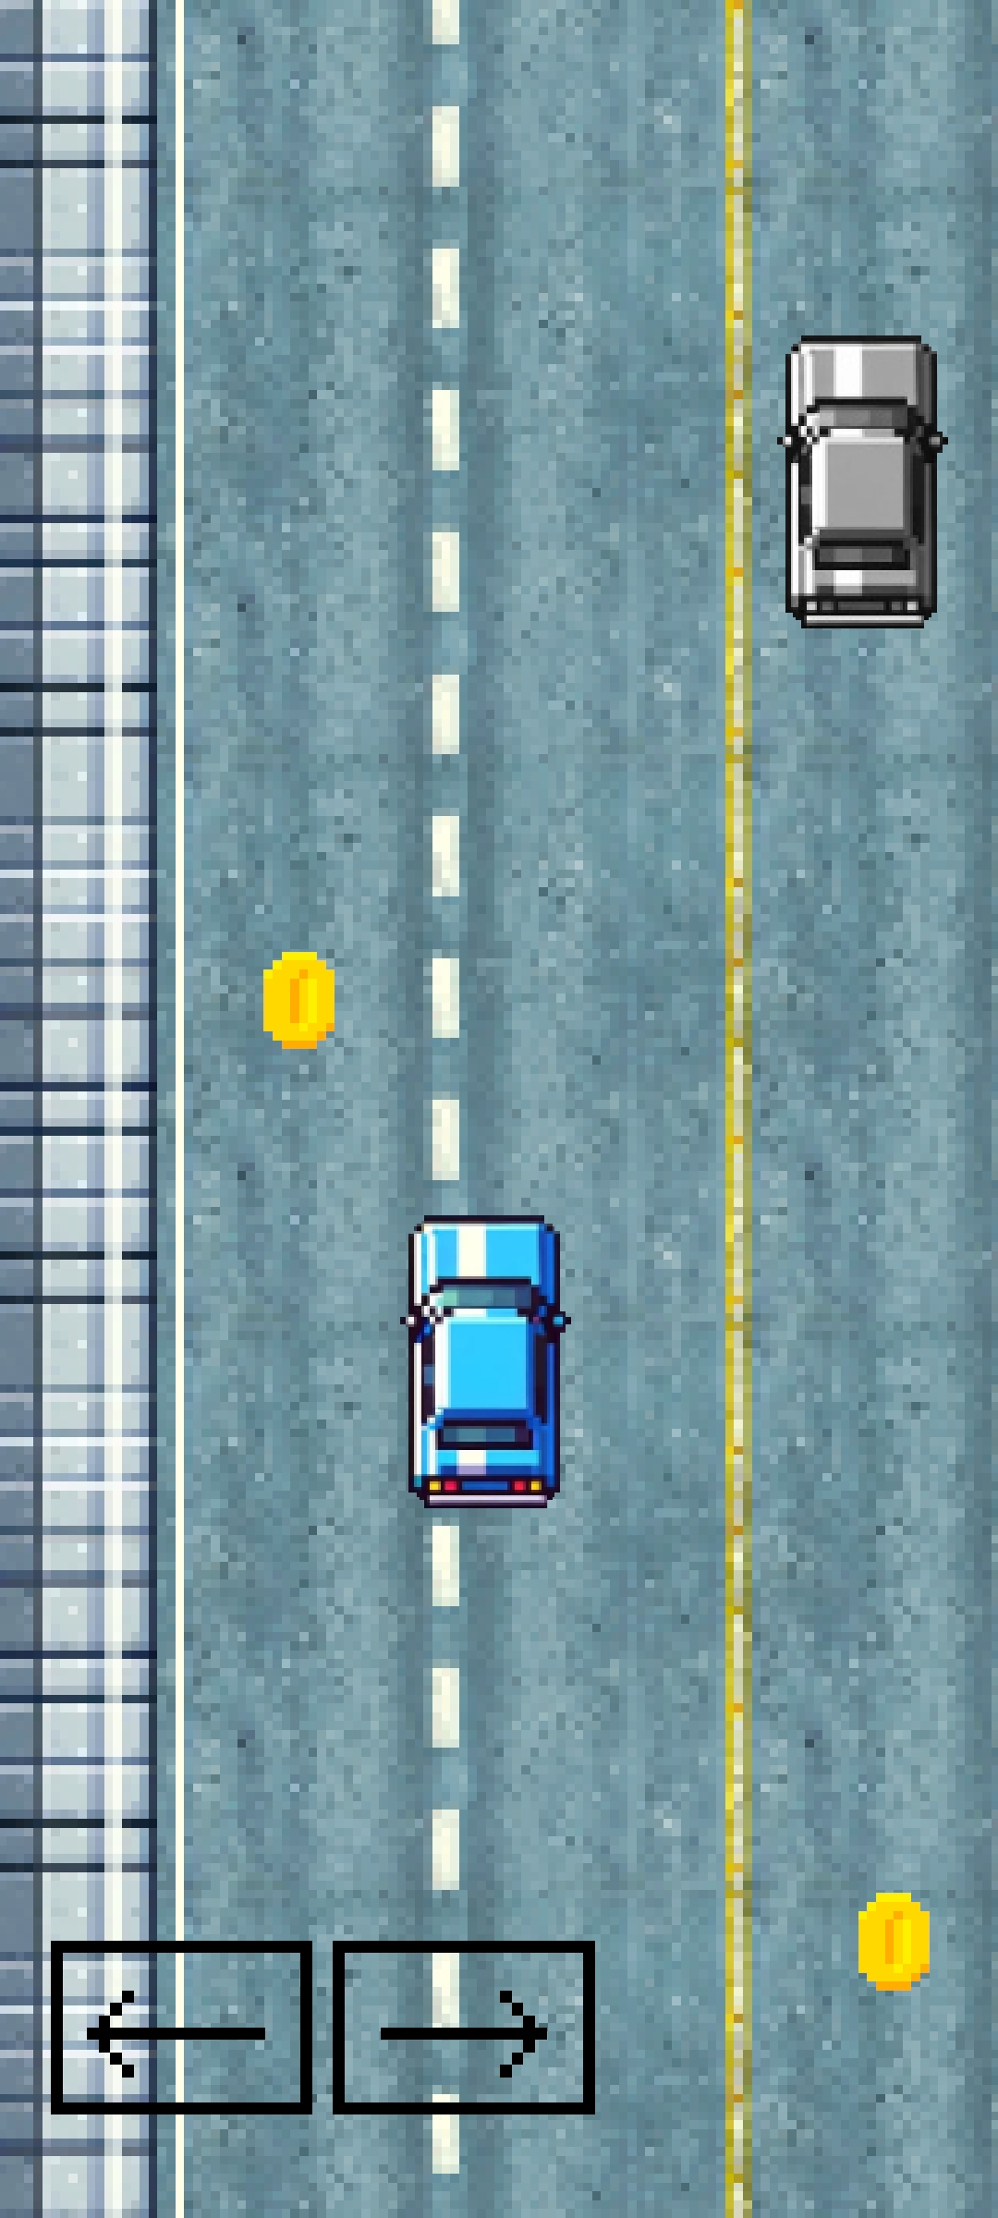
Interface
Game controls will be located on the touch screen. User will be swiping on the left and right side to change taxi’s location. Player will be moving forward all the time, but to slow/stop the car, he will need to hold the screen.
There will be also an option the change controls to basic buttons.

Slide 7
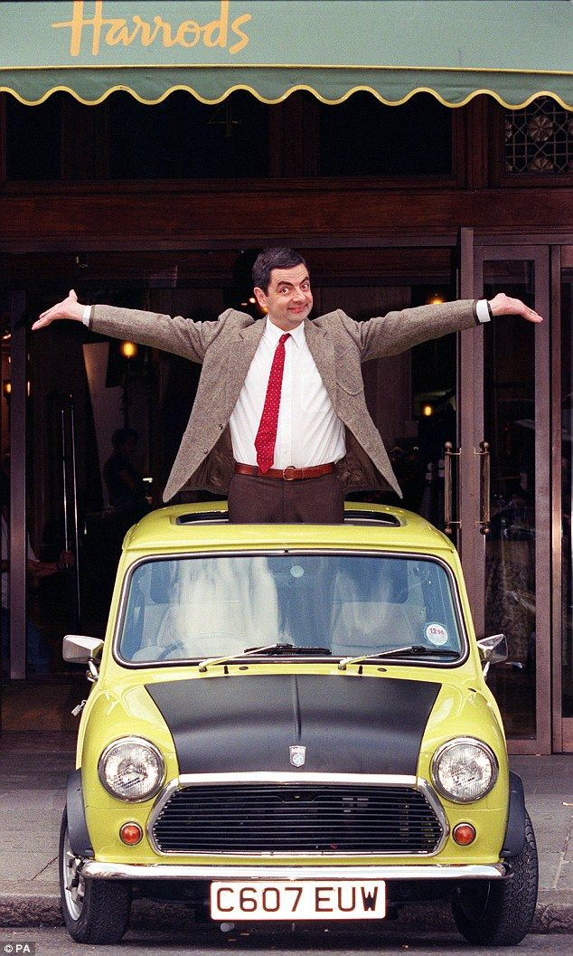
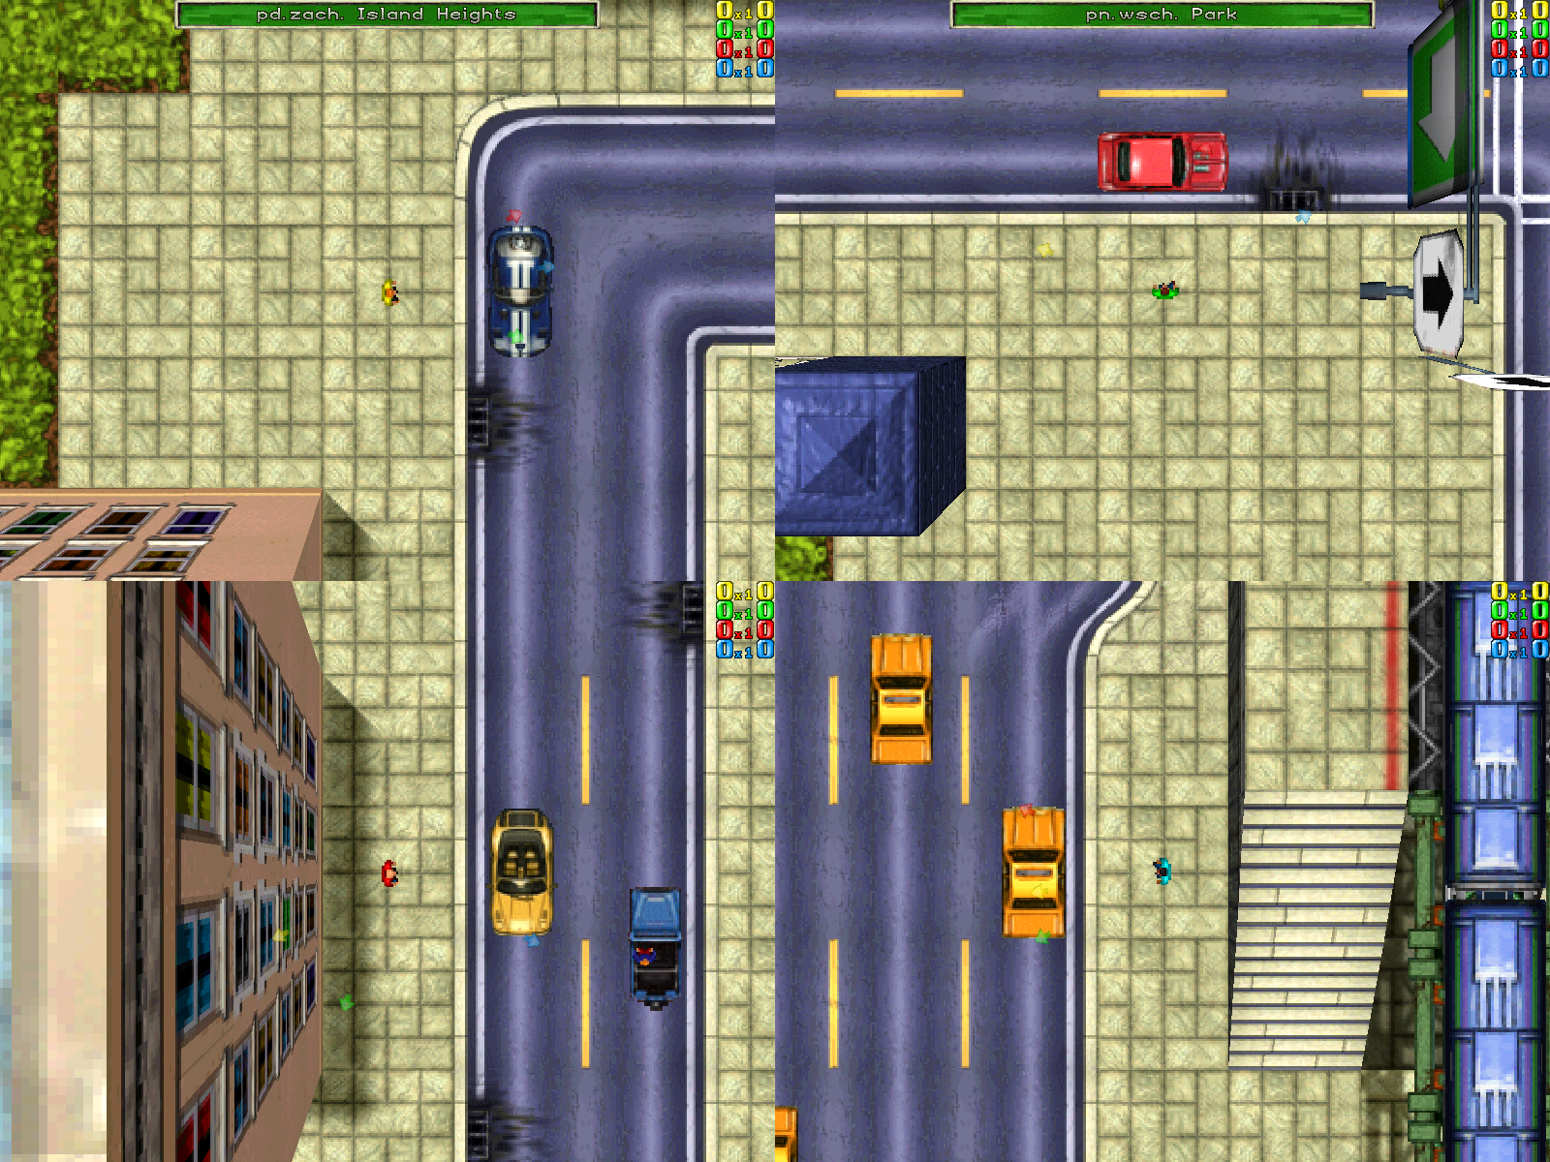
Art Style
Our style were inspired by films about Mr. Bean and their atmosphere as well as by first GTA games. Our main idea was to recreate GTA 1 experience for the players.
We decided to choose the pixel art style because it expresses our vision better than others.

Slide 8

Music/Sound
Taxifire will have a catchy and fast soundtrack that will motivate the player to drive faster. What we are trying to achieve can be heard here:
https://www.youtube.com/watch?v=8ak7O78HQnw&list=PLQQHEdexmxUGij0ESsHleRPDqcpoEhr8Y&index=14&ab_channel=AShamaluevMusic
https://www.youtube.com/watch?v=A-U4PPWr5ZQ&list=PLQQHEdexmxUGij0ESsHleRPDqcpoEhr8Y&index=1&ab_channel=AShamaluevMusic

